Slide 1

Deep Convolutional Forest: A Dynamic Deep Ensemble Approach for Spam Detection in Text
BACHELOR OF TECHNOLOGY
in
SKILLTIMATE INTERNSHIP
Submitted by:
B.SWETHA(20J41A6707)
G.SRILATHA(20J41A6720)
Department Of Computer Science And Engineering In Data Science
Malla Reddy Engineering College(Autonomous)
Maisammaguda,Dhulapally,Via Kompally,Secunderabad-500100

Slide 2

ABSTRACT
Spam detection in text-based communication has become increasingly challenging due to the evolving tactics employed by spammers. In response to this challenge, we introduce a novel approach called the "Deep Convolutional Forest" (DCF) for effective spam detection. DCF combines the power of deep learning and ensemble methods to create a dynamic and robust spam detection system.

Slide 3


INTRODUCTION
Now-a-days almost everything is available on internet such as traffic information, news, online banking, chat with friends and many more and this advantage leads a security issue where come malicious hackers can post Fake news or can steal information from network while sending request to bank or any other servers and to avoid such spamming or stealing many machine learning and deep learning algorithms are introduced but this algorithms has two limitation where ML require manual features for training and deep learning can extract features automatically but its computation cost is high.

Slide 4

OBJECTIVE
A Dynamic Deep Ensemble Approach for Spam Detection in Text" is to develop an innovative and effective method for detecting spam in textual data using a dynamic deep ensemble approach based on deep convolutional forests.
This research aims to address the following specific objectives:
Spam Detection Accuracy
Deep Learning Integration
Efficiency
Security and Privacy
Real-World Deployment

Slide 5
TECHNICAL OBSERVATIONS:DFC ALGORITHM MODULES
Dataset over-sampling:
Convolution Neural Network:
Convolution Neural Network: This model will filter dataset features multiple times so we will have relevant and important features required to predict message as HAM or SPAM
Random Forest & bagging Classifier:bagging classifier will take base estimator as Random Forest
Existing Algorithm:SVM accuracy comparing with Convolution and DCF algorithms accuracy.
Dataset over-sampling:To balance dataset we have used SMOTE algorithm which will generate new records to balance dataset

Slide 6

METHODOLOGY
To implement this project we have designed following modules
Upload SMS Dataset
Preprocess & Word Embedding Vector
Run SMOTE Over-Sampling Dataset
Run Existing Algorithm
Convolution Based Features Extraction
Run Propose DCF Algorithm
Comparison Graph
Spam Prediction from Test Data

Slide 7
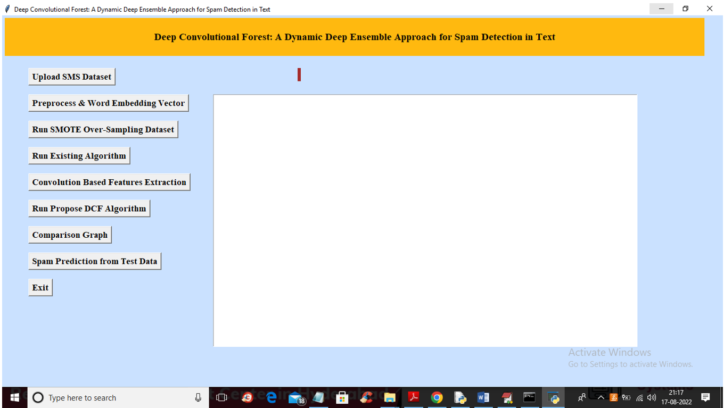
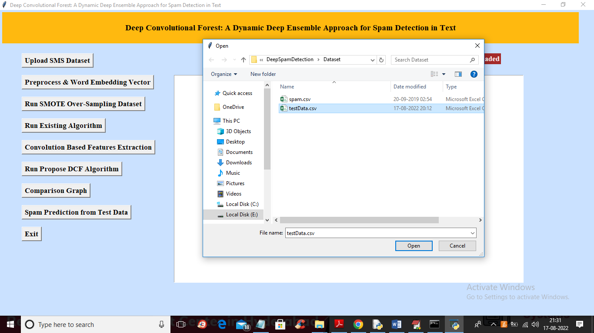
******OUTPUTS******
When we click run.py file to get screen
Uploading the files

Slide 8
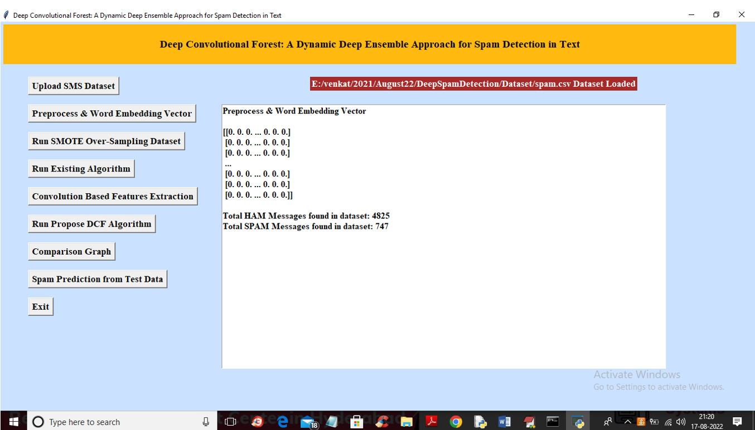
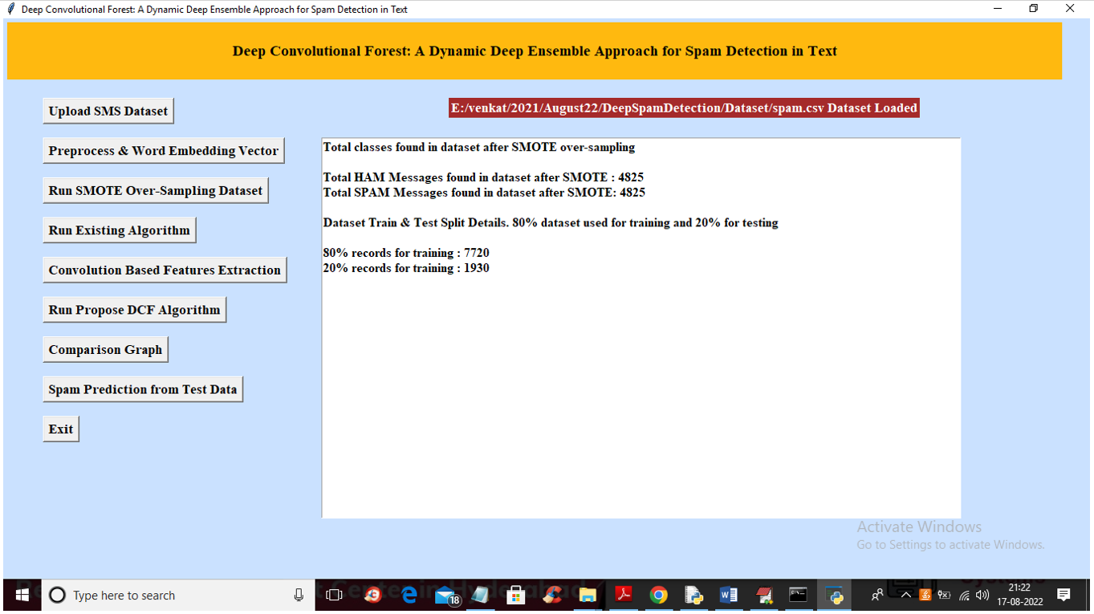
Preprocessing and Word Embedding Vector
Running the SMOTE Over-Sampling Data Set

Slide 9
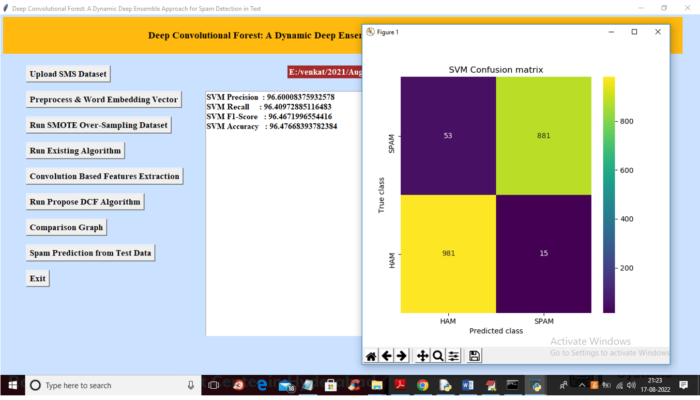
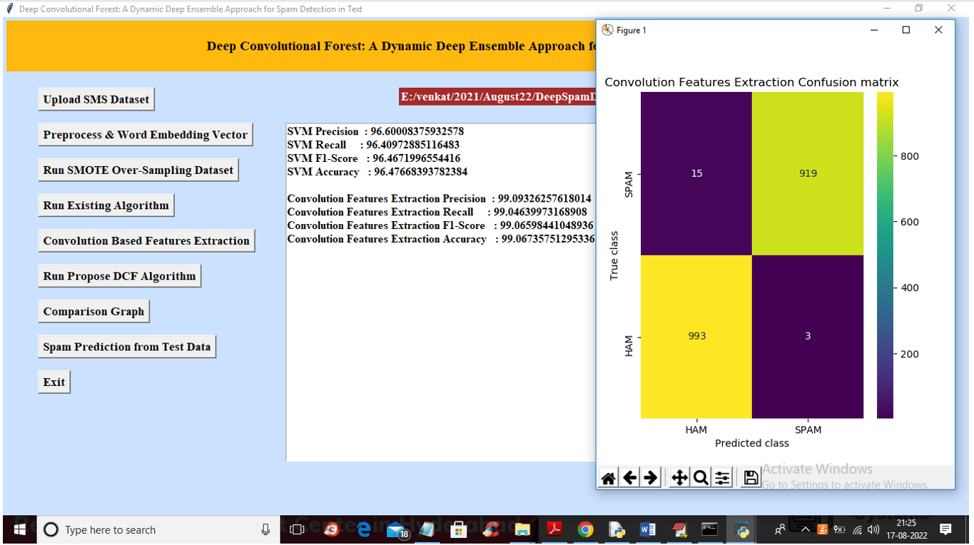
SVM we got 96% accuracy
CNN features extraction we got 99.09

Slide 10
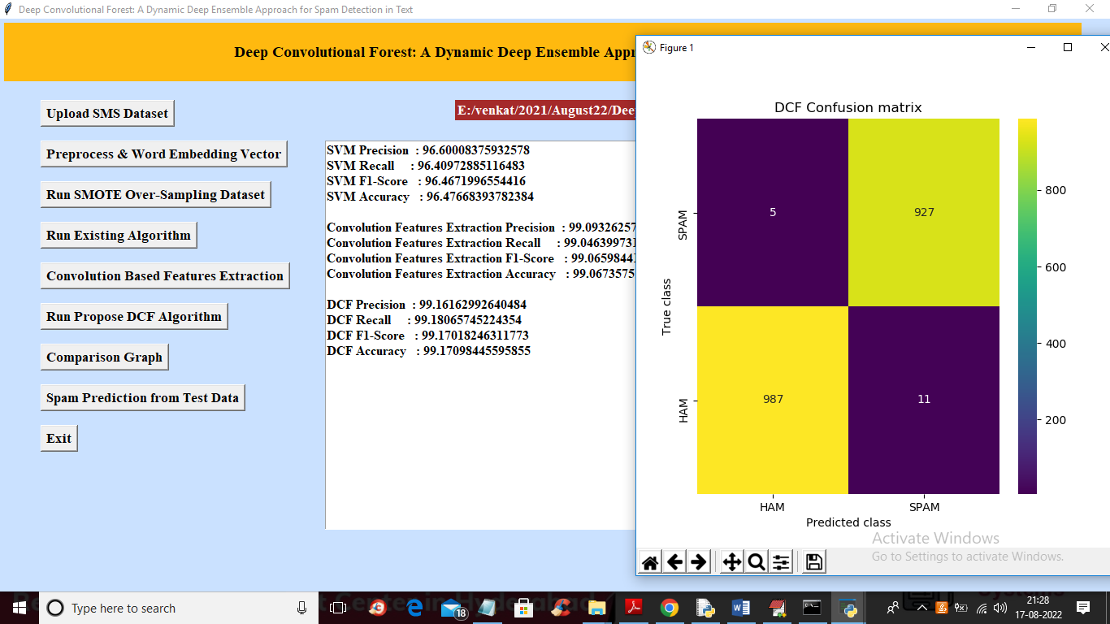
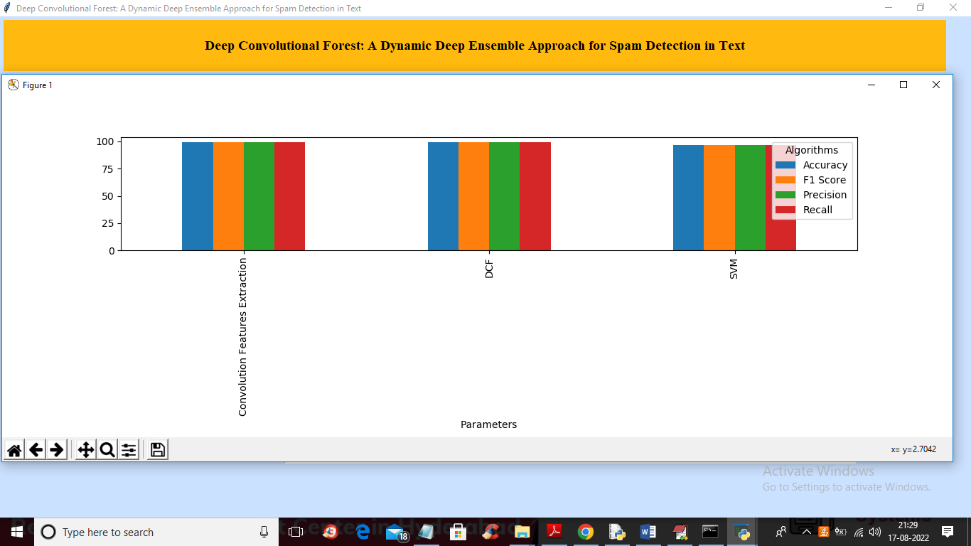
DCF we got 99.16% accuracy
Comparison Graph

Slide 11
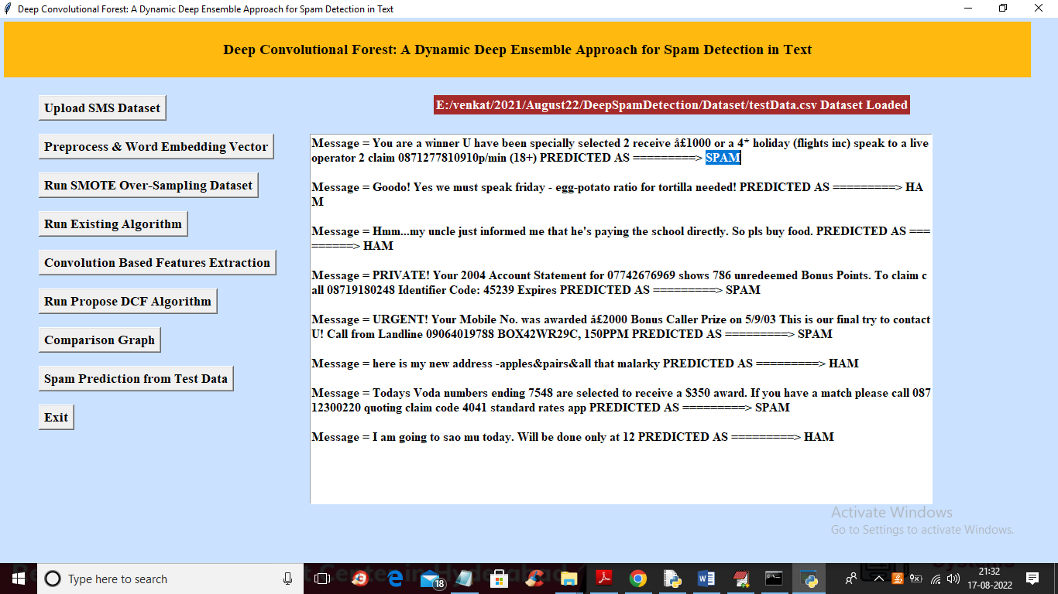
OUTCOME OF DCF
Overall, the outcome of the Deep Convolutional Forest approach for spam detection in text is a more effective and adaptive solution for combatting spam, which benefits both users and organizations by enhancing email and text communication security.
Improved Spam Detection Accuracy
Reduced Impact of False Positives
Research Advancements

Slide 12
CONCLUSION
A dynamic team ensemble model for spam detection that adjust it complexity and extract future automatically the proposal model utilizes convolution and pooling layers for feature extraction along with base classify such as random forest and extremely random as the trees for classifying text into spam or a legitimate once moreover the model implies ensemble learning process like boosting and bagging. As a result model achieved high Precision recall F1 score and accuracy of 99%

Slide 13
ANY QUERIES?

Slide 14
THANK YOU

